Slide 1



Unit 3.1: Fundamentals of Cybersecurity in 5G Networks
Section 3.1.8: PBL - Cybersecurity Risk Analysis in 5G Smart Cities
Part 2: Lab Validation & Threat Modelling Setup
NeoCity scenario - Connected Traffic Signal System
Notes:
This session continues the PBL activity introduced in Part 1, but now our focus shifts from understanding the scenario to hands-on work with the lab environment. In Part 2, you will validate that the NeoCity testbed is running correctly and then prepare the ground for threat modelling and risk assessment.
The first objective is to confirm that the Docker-based lab is healthy. This includes checking that all containers are started, verifying that the expected ports are open, and that key services such as the MEC application, Prometheus, Grafana, and Suricata are reachable. Ensuring a stable environment prevents misinterpretation of later results and separates genuine security issues from simple configuration errors.
Once the environment is validated, we will start collecting evidence that will feed directly into our risk analysis. You will learn how to inspect container status, read basic logs, and confirm that traffic simulation is producing data. These observations will be used to map data flows, identify trust boundaries, and highlight potential attack surfaces.
The second major objective is to prepare for threat modelling of the Connected Traffic Signal System. Building on the workflow from Part 1, we will focus on concrete threats related to telemetry anomalies, data tampering, service disruption, and unauthorized access. The goal is to translate abstract risk concepts into specific threat scenarios grounded in the NeoCity architecture.
By the end of Part 2, you should be confident that the lab is functioning as intended, and you will have a structured view of where threats can emerge in this 5G-enabled smart city service. This will position you to perform a more detailed risk evaluation and to refine security controls in the final part of the PBL.

Slide 2
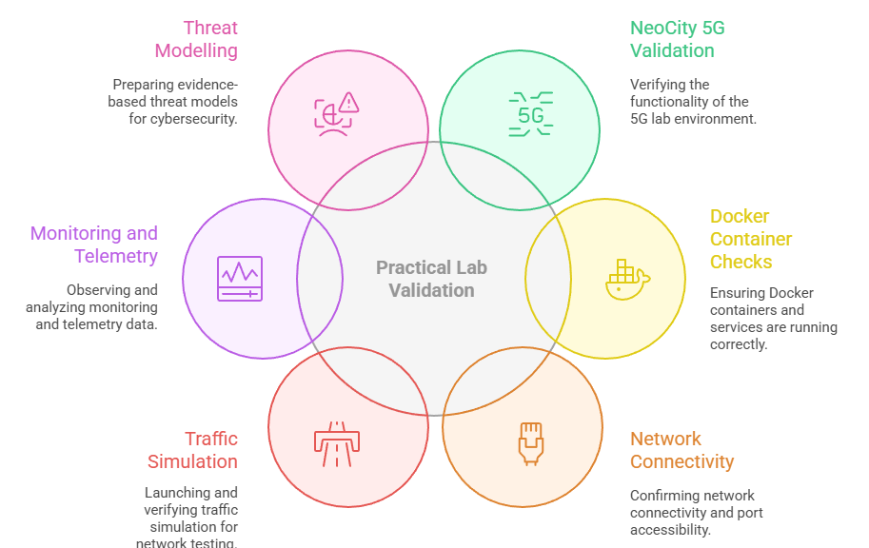

1. Practical Lab Validation & Threat Modelling Setup
Validate the NeoCity 5G lab environment
Check Docker containers and running services
Confirm network connectivity and exposed ports
Launch and verify the traffic simulation
Observe initial monitoring and telemetry data
Prepare threat modelling with evidence-based insights
Notes:
This part of the activity transitions into fully practical work, and the objectives reflect that shift. The first goal is to validate the NeoCity lab environment. Before performing any cybersecurity analysis, we must make sure the testbed is running correctly. A significant number of cybersecurity issues arise not because systems are attacked but because of misconfigurations or service failures, so this validation step is essential.
You will inspect the Docker containers that compose the NeoCity infrastructure, ensuring that Open5GS, the MEC application, Suricata, Prometheus, Grafana, and the traffic generator are all running properly. We will confirm that each component exposes the correct network ports, responds to basic connectivity checks, and integrates with the rest of the system.
Next, we will start the traffic simulation to generate the telemetry used by smart traffic lights. This provides the operational data that both monitoring tools and the attack surface rely on. We will verify that monitoring dashboards receive real-time traffic events, which will later allow us to detect security anomalies and validate countermeasures.
By carrying out these checks, you collect evidence that will be directly applied in the threat modelling exercise. Observing how data moves across components helps identify trust boundaries, exposed interfaces, and possible entry points for attackers.
In summary, these objectives ensure that you are operationally prepared. Once the environment is confirmed to be healthy, we can confidently proceed with threat identification, risk evaluation, and security enhancement during subsequent steps of the PBL.

Slide 3
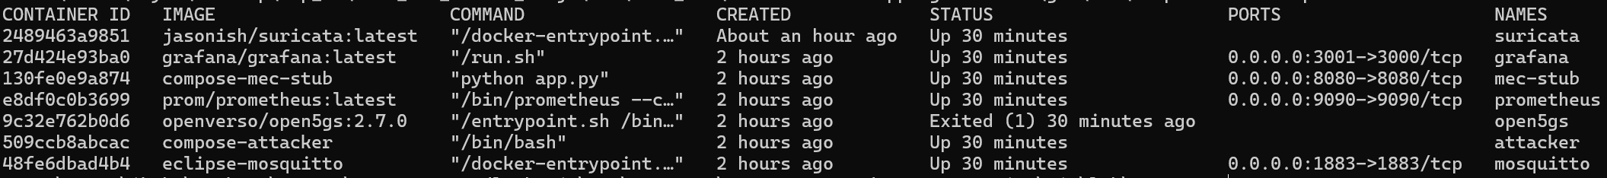
2. Docker Lab Services Overview
mec-stub: Simulated MEC application for traffic-control logic
Mosquitto: MQTT broker carrying telemetry data
Suricata: Network IDS monitoring NeoCity traffic flows
Prometheus: Collects metrics from lab services
Grafana: Dashboards for visualising telemetry and alerts
Attacker: Container used to generate test attacks and anomalies
$ docker ps -a
Notes:
You are working with a containerised lab where each service has a specific role in the NeoCity scenario. This slide helps you understand what runs inside Docker before you start validating and using the tools.
The mec stub container represents the MEC application responsible for processing telemetry and making traffic control decisions. It is the logical focus of many of the threats that you will analyse later in the PBL.
The mosquitto container acts as the telemetry broker, carrying messages from simulated roadside devices into the MEC layer. If this service is down, you will not see realistic data flows in the rest of the lab. Although you do not directly interact with it in this scenario, Suricata monitors its traffic to detect abuse that could disrupt availability, which is a key security requirement in connected urban services.
The suricata container provides network intrusion detection. It inspects traffic between components and raises alerts when it observes suspicious flows or signatures. Suricata is one of your main sources of security evidence.
The prometheus container continuously collects metrics about the behaviour of the other services, such as request rates and latency. The grafana container reads these metrics and displays them in dashboards, giving you a visual view of what is happening in the system.
Finally, the attacker container is a controlled environment where you will run scripts or commands that simulate misconfigurations and attacks. It allows you to create realistic security events without touching your host system.
In summary, these services together form the operational playground for this PBL.
When validating your lab environment, one of the first and most effective checks you can perform is running the docker ps -a command. This command lists every container that exists on your system, including those that are currently Up and those that have Exited. Understanding this output will help you quickly diagnose whether your lab is ready to support the upcoming security exercises.
You can start by confirming that the core services are in a healthy state. In this lab, the most important containers are mec-stub, mosquitto, suricata, prometheus, grafana, and attacker. Each of these plays a critical role in your security observations. If any of these containers are not running, telemetry may fail, alerts may not be generated, or visualisation dashboards may appear empty.
The STATUS column indicates whether a service is currently operational. Look for the term Up, which tells you that Docker has successfully launched that service. If you see Exited, it means the container stopped shortly after starting, usually due to a configuration or boot error.
The PORTS column is also important. It shows whether required services are accessible from your host system. For example, Grafana should be reachable on port 3001, and Prometheus on 9090. Verifying these ports avoids troubleshooting later when trying to access dashboards or metrics.
If a service is not Up, you can run docker logs <container name> to review error messages and understand what failed. For most issues, logs will provide direct clues and solutions.
Finally, you may notice that Open5GS appears as Exited. The full deployment of a 5G core introduces additional dependencies and configuration steps that go beyond the objectives of this practical exercise. You do not need Open5GS running to successfully complete the security and monitoring workflow that follows.

Slide 4
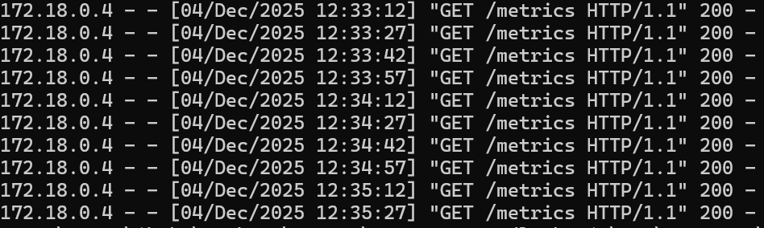
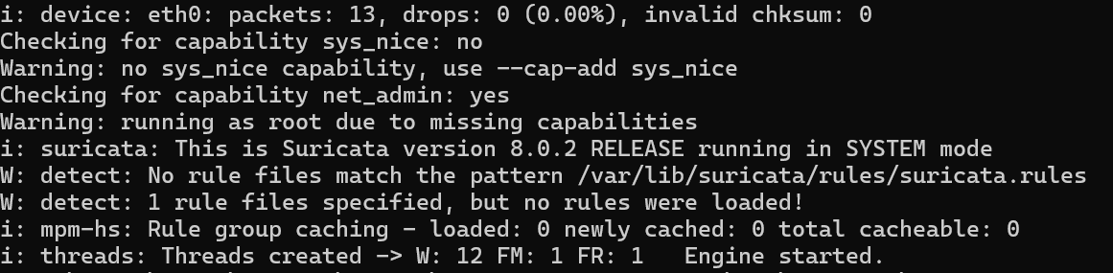
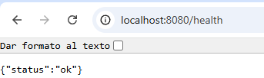
3. Service Status & Logs Inspection
Validate critical services are healthy
Inspect logs for errors or warnings
Confirm that the MEC app and monitoring are functioning
Check data flow between components (MQTT → MEC → Suricata)
$ docker logs mec-stub --tail 1
$ docker logs suricata --tail 1
Metric confirmation
Notes:
In this step, you are no longer checking whether containers are simply running. You are validating that key services are actually performing their role inside the NeoCity lab environment. Each component must produce operational output that shows data flow through the system.
We begin by inspecting the MEC stub service. In the example shown on the slide, the logs display repeated HTTP GET requests to the metrics endpoint. This means the service is alive, responding to queries, and interacting correctly with the monitoring stack. If your logs were empty or full of errors, that would indicate a data pipeline issue that must be corrected before continuing the practical activities.
Next, we check the behavior of Suricata. The logs confirm that Suricata has initialized properly, loaded its detection engine, and is monitoring network traffic on eth0. At this phase of the exercise, alerts are not expected yet. What matters is that Suricata shows thread initialization, rule processing, and packet statistics. If Suricata prints errors about missing interfaces or never increases packet counters, it is likely not receiving traffic from the MEC network.
We then verify that the MEC health endpoint returns a positive status response. This demonstrates that communication between the MEC application and the host machine works correctly and that the system will be able to report performance metrics later when attacks are introduced.
A green status in logs and HTTP results signifies a stable environment. This validation step protects you from troubleshooting avoidable failures later during the cybersecurity tasks.
Note to students: The Open5GS core service is intentionally omitted from the scope of this practical session. It requires additional configuration, such as database provisioning and network bindings. Its lifecycle and logging are more complex than needed for the learning objectives here. You do not need to validate it for this PBL.

Slide 5
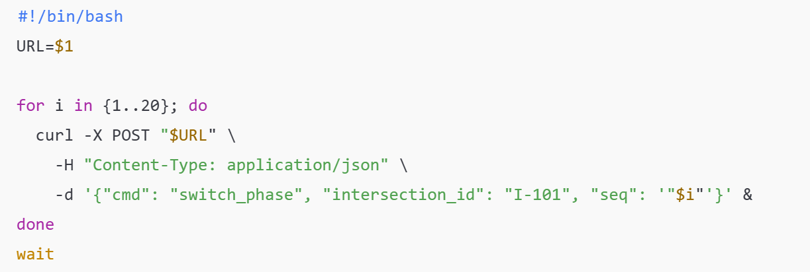
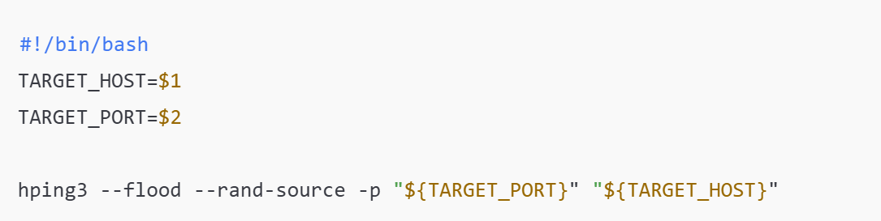
4. Simulating Unauthorized Traffic (Attack Surface)
The attacker container generates traffic as an external adversary
Two attack types targeting the MEC API:
                Integrity: unauthorized control commands (api_bypass.sh)
                Availability: flooding DoS traffic (dos_test.sh)
      Helps evaluate how monitoring detects and responds to malicious behavior
      Shows how security failures impact smart-city operations
traffic flood, dos_test.sh
Integrity attack, api_bypass.sh
Notes:
This slide introduces how we simulate cyberattacks within our NeoCity smart-traffic lab environment. Up to this point, you have verified that all critical services are running and that monitoring is active. Now, we want to generate malicious traffic from a controlled attacker source to test how the system reacts.
The attacker container is designed to represent an untrusted device on the network. It allows us to trigger two common cybersecurity threats that impact safety-critical industrial systems such as traffic signal controllers.
The first script, api_bypass.sh, sends multiple unauthenticated commands to the MEC control API. In a real deployment, these commands should only come from trusted and authenticated platforms responsible for traffic operations. By bypassing authentication, we directly challenge the integrity of the smart-city service. If an attacker manipulates traffic-light phases at the wrong time, it could create dangerous intersections or disrupt emergency-vehicle priority systems.
The second script, dos_test.sh, generates a high-volume packet flood toward the MEC API using the hping3 tool. This represents a Denial-of-Service (DoS) attack, where the adversary’s objective is to degrade performance or even exhaust system resources. When availability is compromised, traffic decisions may become delayed or inaccessible, hurting the ability of the system to operate safely.
By running these attacks in isolation, we can analyze multiple aspects:
How do different services behave under stress? Do we observe anomalies in logs or metrics? Does the monitoring stack detect abnormal behavior? Each observation will feed directly into your risk analysis and mitigation proposals later in the activity.
Finally, keep in mind that these scripts generate controlled and limited attacks purely for educational purposes. They give you a safe way to study how weak security controls can lead to serious consequences in a modern 5G-enabled smart-city system.

Slide 6
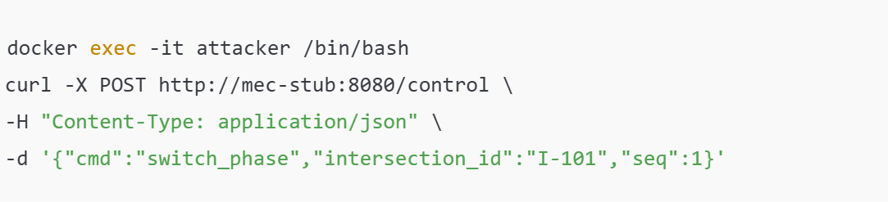
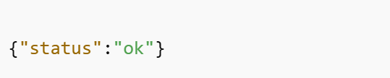
5. Baseline API Test (Legitimate-Like Command)
Send a single request to the MEC control API
Validate service responsiveness
Observe MEC logs updating
Establish a baseline before launching attacks
Request simulation
Expected response
Notes:
Before launching full attack scripts, it is important to confirm how the MEC application normally behaves when receiving a single command. This provides a baseline for interpreting anomalies later in the exercise.
In this step, you execute a direct HTTP POST request from the attacker container to the MEC control API. The command mimics a real instruction that an authorized traffic-management component might send. It contains a traffic light phase control message for intersection I-101 along with a sequence number. The goal is to check if the service accepts the message and responds properly under normal conditions.
When the command succeeds, you should see a short JSON response such as {"status":"ok"}. This indicates that the MEC application received the message, processed it, and updated its internal state. If you inspect the MEC logs, you will observe exactly one logged control action. At this stage, the system’s behavior appears legitimate, and there are no signs of security enforcement or access-control validation.
The key takeaway is that the MEC service currently trusts the sender implicitly. There is no authentication or authorization step verifying whether the request originates from a valid operational component or from an attacker. This is a critical security gap that affects integrity within the smart-city infrastructure.
By establishing a clear baseline, you will be able to understand how the system reacts when its behavior becomes abnormal. On the next slide, you will execute a sequence of malicious commands to observe both service stress and security monitoring reactions through tools like Suricata and Grafana.

Slide 7
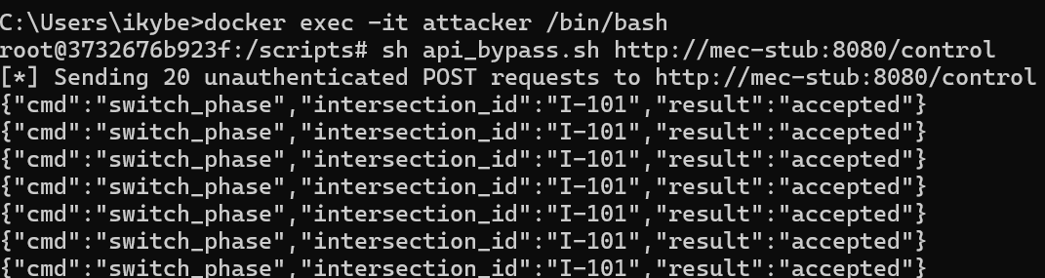
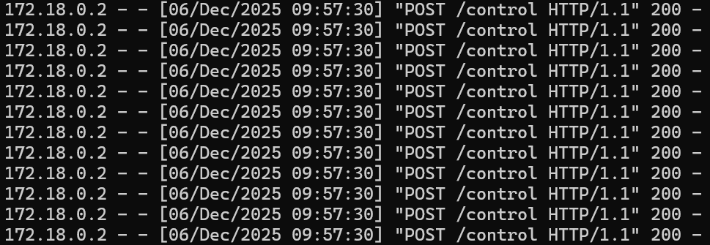
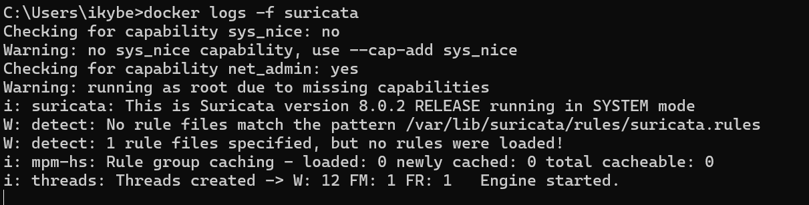
6. Suricata Detection Begins (Integrity Violation)
Execute initial unauthorized control sequence
Trigger access-control misuse indicators
Observe MEC log anomalies
Check Suricata alerts start appearing
Docker logs –f mec-stub
Docker logs –f suricata
Attack simulation
Console windows | What it shows | Purpose
Terminal (attacker) | api_bypass.sh sending 20 POSTs | Evidence of malicious activity
MEC logs | Multiple control requests processed rapidly | Detect operational anomaly
Suricata logs | First alerts or warnings appearing | Confirms monitoring pipeline works
Notes:
Now that you have confirmed normal control interactions, the next step is to introduce a burst of unauthorized commands and observe whether the system identifies anything unusual. You will use the api_bypass.sh script that sends multiple parallel POST requests to the MEC control API. In a real deployment, these commands should only originate from privileged system components, but here they are executed by an attacker without any security clearance.
Once the script runs, you should see a rapid sequence of commands targeting the same traffic intersection, with increasing sequence numbers. The MEC application will still respond with successful operations, because it does not enforce authentication or authorization. This makes the attack an example of an integrity violation, where the adversary attempts to manipulate the system’s physical behavior.
While this simple attack may not immediately disrupt service availability, it leaves clear traces in operational logs. In the MEC logs, an unexpected burst of control activity can already be considered suspicious, especially outside scheduled control windows. At the same time, Suricata begins analyzing network packets associated with the control requests. You may start to observe early alert triggers or classification messages in Suricata’s output, indicating that the monitoring system has detected command-level anomalies.
What matters here is the visibility of the attack, not yet its severity. You are starting to see how the security monitoring pipeline helps identify misuse that would otherwise remain hidden behind valid-looking traffic. This exercise demonstrates the first key concept in operational cybersecurity: systems do not have to fail to be under attack.
At this moment, you may notice that Suricata does not surface any alerts. This is an intentional learning point: even when misuse is happening, a security monitoring system without active rules provides zero visibility. In the next steps, you will activate detection rules and observe how the system begins revealing the attack.

Slide 8
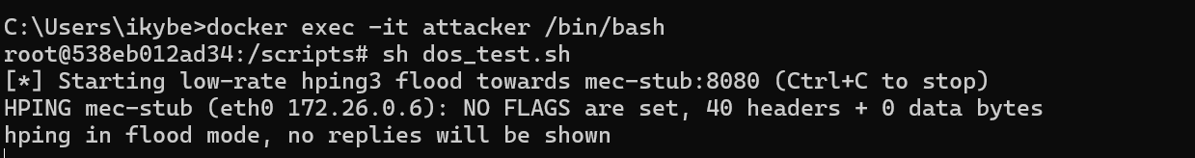
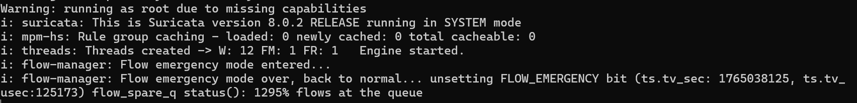
7. Suricata Detection (II)
Suricata.rules
Create proper IDS rules to detect attack patterns
Launch a DoS flood simulation from attacker
Observe flow emergency mode being triggered
Confirm Suricata alerts are generated in logs
#alert tcp any any -> any 8080 (msg:"NeoCity MEC control access"; sid:1000001; rev:1;)
alert tcp any any -> any 8080 (msg:"NeoCity possible DoS flood to MEC API"; threshold:type both, track by_dst, count 50, seconds 5; sid:1000002; rev:1;)
alert tcp any any -> any 1883 (msg:"NeoCity possible DoS flood to MQTT broker"; threshold:type both, track by_dst, count 50, seconds 5; sid:1000003; rev:1;)
Attack simulation
Docker logs –f suricata
tail –f /var/log/suricata/eve.json | grep ”\”alert\””
Notes:
In this activity, we are validating the detection capabilities of our IDS component, Suricata. After ensuring that Suricata successfully monitors the network traffic, we introduce custom rules that help identify malicious behaviors specific to our MEC environment. The rules we created focus on high-rate SYN traffic targeting the MEC API port (8080) and the MQTT broker port (1883). These are important services in our architecture and could easily become victims of a DoS attack in a real deployment.
Once the rules are in place, we generate a flooding attack from the attacker container using hping3. The script repeatedly sends SYN packets toward the target without completing the TCP handshake. This behavior is typical of SYN flood attacks, which can overwhelm servers by exhausting connection queues.
During this simulation, Suricata switches into flow emergency mode. This internal protective mechanism activates when Suricata experiences an unusually large number of flows in a short time. It prioritizes essential processing paths in order to keep inspecting traffic under stress. Seeing this in the logs confirms that the attack has a noticeable impact on the monitored network.
The most important part is verifying the alerts generated from our custom rules. We do this by monitoring Suricata’s main event output file, eve.json, and filtering for entries of type alert. Each alert contains metadata such as source and destination IP addresses, destination ports, the signature ID (SID) of the rule that triggered, and a short message that explains what was detected.
With this full workflow, we have demonstrated that Suricata can detect traffic anomalies introduced by our attacker. You can now clearly see the path from threat simulation to visibility and alerting in the IDS. This is essential knowledge for practical network security operations.

Slide 9
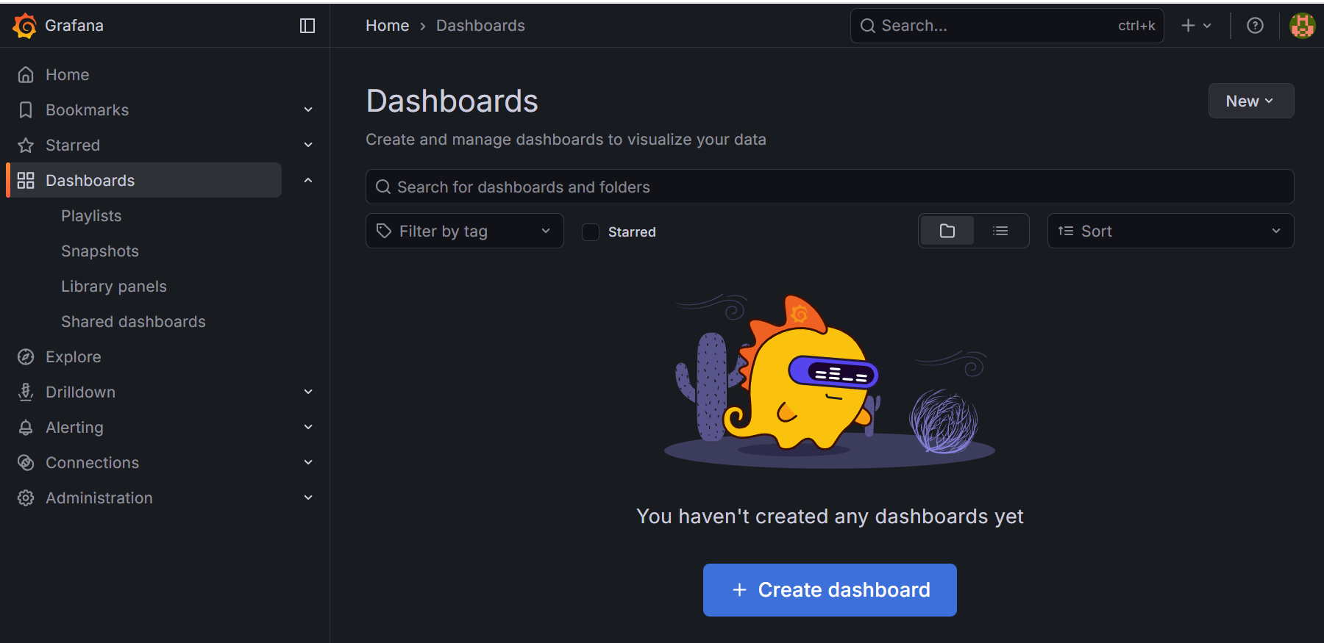
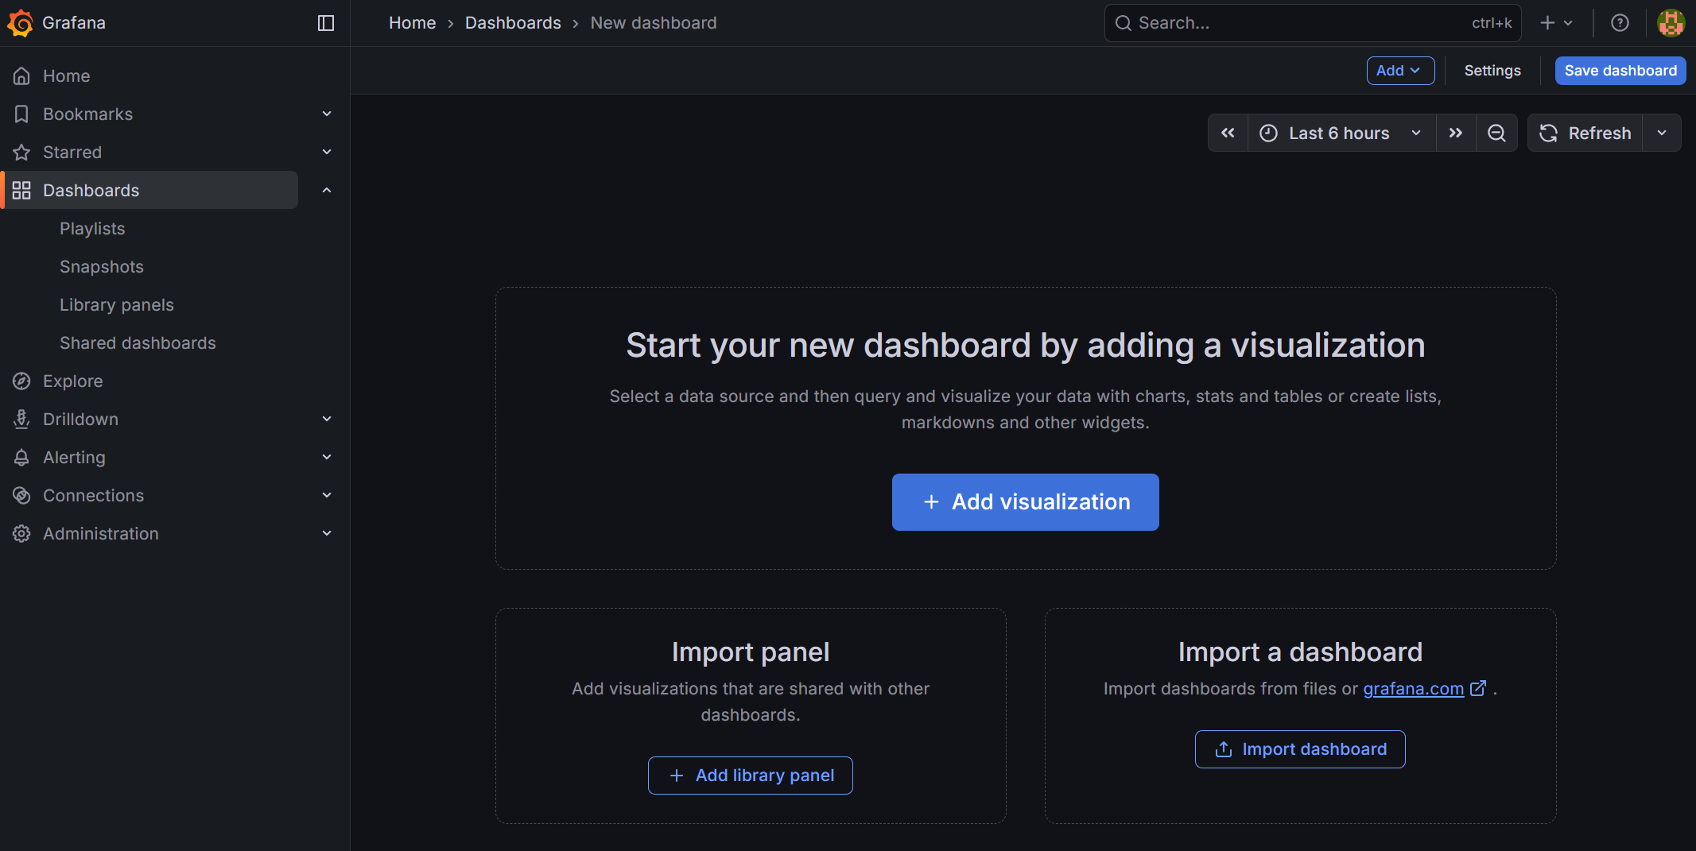
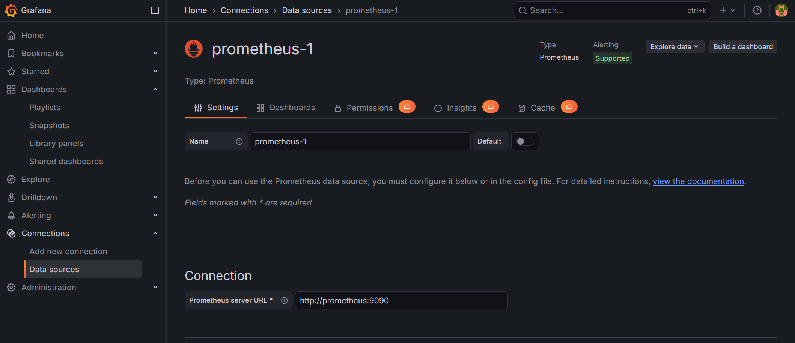
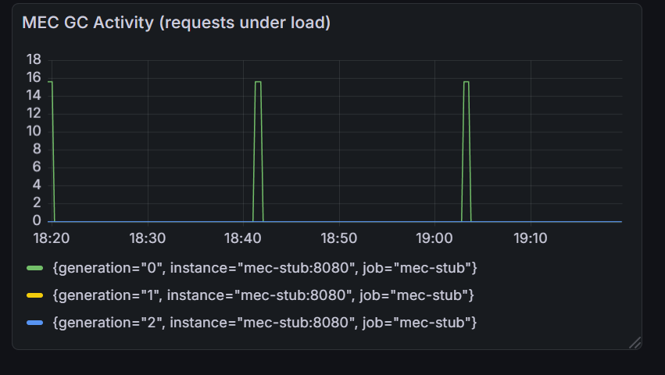
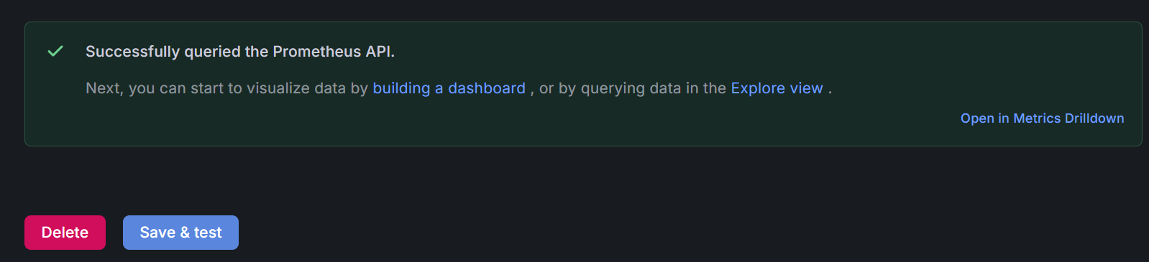
8. Monitoring Security Metrics in Grafana
Open Grafana in your browser (http://localhost:3001 and log using default credentials: <admin, admin>)
Configure Prometheus as the Data Source (set URL to http://Prometheus:9090, then click ‘Save & Test’)
Create a new Dashboard and add a new Panel (Select Prometheus as Query source and choose Code mode). Set rate(python_gc_objects_collected_total{job="mec-stub"}[1m]) and visualization to TimeSeries
Notes:
In this step, you will connect monitoring and security by visualizing real-time metrics from the MEC service using Grafana.
You already verified Suricata detections and examined logs, but monitoring provides a broader operational view. It allows you to observe performance changes, detect abnormal load patterns, and validate attack impact through measurable indicators.
First, you access the Grafana web interface through your browser. Once logged in, you configure Prometheus as the data source, since Prometheus is responsible for collecting metrics across the NeoCity environment. When you click Save & Test and see a successful response, you confirm that Prometheus is reachable from Grafana inside Docker.
You then create your first dashboard, which acts as your monitoring workspace. By adding a time-series panel, you start transforming raw telemetry into security insight.
In the query editor, you switch to Code mode and enter the PromQL query:
rate(python_gc_objects_collected_total{job="mec-stub"}[1m])
This metric reflects the internal workload of the MEC service. The more incoming requests the MEC receives, the more objects are created and later cleaned by the Python Garbage Collector.
When the system is under normal conditions, the chart displays a stable or low-activity line. However, when you launch a DoS simulation from the attacker container, the MEC faces a surge in incoming network packets and processing load. This results in visible spikes in the graph.
These spikes represent the operational footprint of the attack. Even if the attacker does not fully establish TCP connections or generate explicit HTTP requests, the increase in traffic pressure still affects the system. The dashboard provides immediate evidence of that behavior.
By combining security alerts from Suricata with performance telemetry from Prometheus and Grafana, you now begin forming a complete picture of how threats affect availability and resilience in 5G-enabled systems. This understanding will support your risk evaluation and mitigation decisions in the final part of this PBL activity.

Slide 10
9. Correlating Security Evidence in NeoCity
DoS flood generates measurable impact on the MEC system
Performance metrics in Grafana show spikes linked to attack activity
Suricata alerts confirm malicious traffic patterns
Security observations now feed the risk evaluation
Next step: propose mitigations and validate residual risk
Correlation between the events detected in Suricata and the metrics observed in the MEC from Grafana
Notes:
Up to this point, you have executed two types of attack scenarios and validated that they produce observable effects inside the NeoCity environment. In this slide, you learn how to correlate that evidence in order to build a risk-based security conclusion.
When you launched the DoS flood from the attacker container, the MEC service was forced to process a significantly higher number of packets and related operations. This resulted in increased internal activity, which you could see as spikes in the Grafana time-series panel. Even without successful HTTP sessions, the pressure on the system is visible at the performance level.
At the same time, Suricata identified the abnormal packet bursts and triggered alerts according to the custom rule you added earlier. Suricata confirms the malicious intent of the traffic, while Grafana confirms the operational impact on the target.
This combination of evidence allows you to map the scenario directly to the risk analysis performed in Part 1 of the PBL. There, you identified Availability as a key cybersecurity objective for MEC systems supporting Smart City operations. Now you see how an attacker could degrade the service, and you have evidence to support your assessment.
With logs and metrics aligned, you can now assign likelihood and impact values with greater confidence. This demonstrates how observability strengthens cybersecurity decision-making and avoids relying only on assumptions at design time.
In the next part of the PBL, you will use this evidence to propose mitigations that improve resilience against similar attacks. You will also identify any residual risk that remains after applying countermeasures, completing the connection between security monitoring and risk management in 5G-enabled environments.

Slide 11
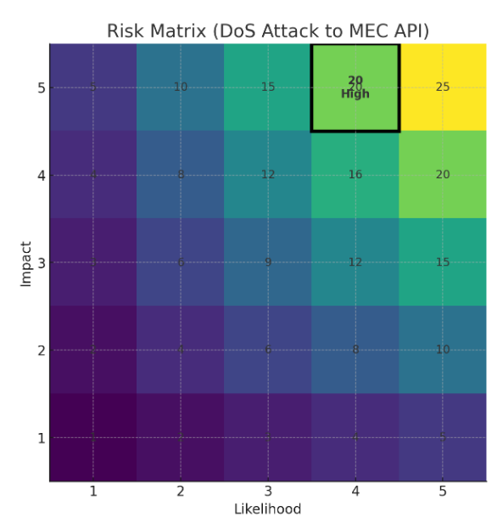
10. Risk Evaluation
Threat considered: DoS flood against MEC control API
Target impact: Traffic signal service availability
Likelihood: Demonstrated viable under current conditions
Impact severity: Disruption to Smart City operations
Risk level: Prioritized for mitigation
Threat | Likelihood (1–5) | Impact (1–5) | Risk = L × I | Priority
DoS attack on MEC control API | 4 | 5 | 20 (High) | Mitigate immediately
Notes:
At this point, you have gathered operational evidence that the attack simulated from the attacker container successfully stressed the MEC control API. This means that the threat we are evaluating is no longer theoretical: you have demonstrated that an attacker with basic network access can attempt to overwhelm the service.
To translate these observations into a formal risk decision, you now score the threat using a standard likelihood–impact model inspired by NIST SP 800-30. In this context, likelihood represents how feasible it is for the attack to happen in real conditions. Since no strong authentication or rate-limiting controls were observed, and the simulated attack was effective, the likelihood is rated 4 out of 5.
The potential consequences of this threat affect the availability of a service that contributes to public safety decisions, such as traffic-light management. Any disruption in this workflow can translate into congestion, delays, or even unsafe conditions. For this reason, impact is rated 5 out of 5.
Multiplying these values, the resulting risk level is 20, clearly in the High category. A risk at this level requires mitigation actions without delay, as leaving the system in this state would expose NeoCity to operational instability or targeted disruption attempts.
You now have a link between what you observed technically, the Suricata alerting and the Grafana performance spike, and the organisational concern: ensuring availability for Smart City services. This step bridges engineering evidence with risk-based decision-making, which is essential in modern cybersecurity operations.
With this evaluation established, you are now ready to identify the most effective mitigation controls to reduce this risk to an acceptable level.

Slide 12
11. Implement & Validate Mitigation Against Detected Threats
Identify critical services that require protection (MEC API)
Automatically detect and block malicious flows at the edge
Maintain system availability even under attack
Reduce impact through rate limiting or traffic filtering
Continuously monitor alerts and system KPIs
Reassess risk level after mitigation is active
Document residual risk and validate an acceptable security posture
Notes:
At this stage, you have identified a high-risk threat affecting a critical service in the NeoCity environment. The MEC API represents a key interface, and when it becomes unavailable due to a denial-of-service attack, many dependent applications can be disrupted. In cybersecurity, detection is only the first step. Next, you need to deploy mitigation controls to ensure that the system remains operational.
You start by configuring protections near the MEC service. Suricata already helped with detection by raising an alert when the threshold was exceeded. Now you extend its role by enabling response actions such as rate limiting or traffic filtering to stop malicious flows from the attacker. This reduces the impact by limiting the traffic that reaches the MEC API.
After enabling these protections, you continue monitoring both security and operational metrics. In Grafana, you expect to see the request rate and response stability improve even while the attack continues. At the same time, Suricata logs should confirm that malicious packets are being detected and controlled. When availability and performance are maintained, you can conclude that the mitigation has effectively reduced the attack impact.
However, the security process does not end here. You now perform a residual risk validation, which means you reassess the likelihood and impact of the attack under the new conditions. Because service disruption has been limited, the risk level can be downgraded to something more acceptable. This supports decision-making by showing whether additional controls are required or whether the system already meets the required security posture.
To complete this part of the exercise, you update the risk matrix and document the effectiveness of the mitigation strategy. This gives you a structured approach to continuous improvement that continues into the next part of the PBL, where you will explore how these findings influence the overall risk profile of the smart city environment.

